Slide 1
“Regression is like a woman. You never understand it fully. When you think you do, the next model is entirely different”.
- Daksh Itha Wickramasinghe

Slide 2
Multiple Linear Regression
Multiple linear regression means linear in regression parameters (beta values). The following are examples of multiple linear regression:
An important task in multiple regression is to estimate the beta values (β₁, β₂, β₃ etc…)

Slide 3
Regression: Matrix Representation

Slide 4
Ordinary Least Squares Estimation for Multiple Linear Regression
The assumptions that are made in multiple linear regression model are as follows:
The regression model is linear in parameter.
The explanatory variable, X, is assumed to be non-stochastic (that is, X is deterministic).
The conditional expected value of the residuals, E(ε_{i}|X_{i}), is zero.
In a time series data, residuals are uncorrelated, that is, Cov(ε_{i}, ε_{j}) = 0 for all i ≠ j.

Slide 5
MLR Assumptions
The residuals, ε_{i}, follow a normal distribution.
The variance of the residuals, Var(ε_{i}|X_{i}), is constant for all values of X_{i}. When the variance of the residuals is constant for different values of X_{i}, it is called homoscedasticity. A non-constant variance of residuals is called heteroscedasticity.
There is no high correlation between independent variables in the model (called multi-collinearity). Multi-collinearity can destabilize the model and can result in incorrect estimation of the regression parameters.

Slide 6
The regression coefficients is given by
The estimated values of response variable are
In above Eq. the predicted value of dependent variable is a linear function of Y_{i}. Equation can be written as follows:
is called the hat matrix, also known as the influence matrix, since it describes the influence of each observation on the predicted values of response variable.
Hat matrix plays a crucial role in identifying the outliers and influential observations in the sample.

Slide 7
Multiple Linear Regression Model Building
A few examples of MLR are as follows:
The treatment cost of a cardiac patient may depend on factors such as age, past medical history, body weight, blood pressure, and so on.
Salary of MBA students at the time of graduation may depend on factors such as their academic performance, prior work experience, communication skills, and so on.
Market share of a brand may depend on factors such as price, promotion expenses, competitors’ price, etc.

Slide 8
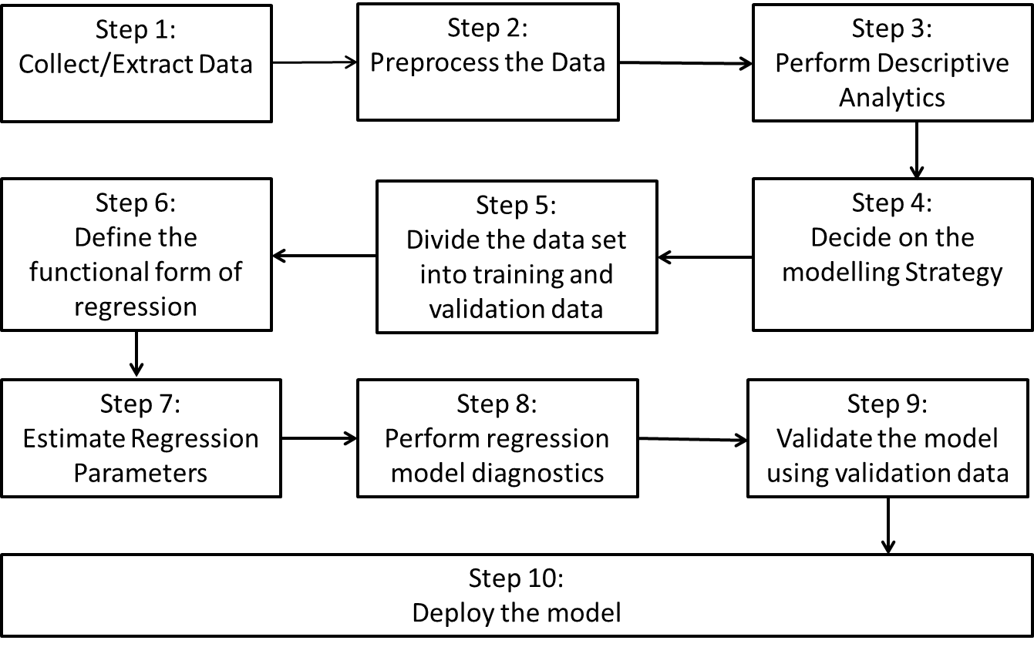
Framework for building multiple linear regression (MLR).

Slide 9
Collect/Extract Data
The first step in regression model is to collect and/or extract data for the problem identified. In case of multiple linear regression model, we will have several independent variables.

Slide 10
Pre-process the Data
Data Quality (measured through several characteristics such as completeness, correctness, etc.): Data completeness refers to availability of necessary data for developing the model.
Missing Data: Many variables may have missing values. The data scientist has to come up with a strategy to handle missing values such as data imputation and specific techniques to carry out the imputation.
Handling Qualitative Variables :Qualitative variables or categorical variables need to be converted using dummy variables before incorporating them in regression model.
Derive new variables (such as ratios and interaction variables), which may have better association relationship with the dependent variable.

Slide 11
Perform Descriptive Analytics
It is a good practice to start the MLR model building with descriptive analytics. In addition to descriptive statistics and data visualizations such as scatter plot and box plot, it is useful to check correlation between different variables since it can provide early warning for issues such as multi-collinearity.
Modelling Strategy
When the number of variables runs into several hundreds, building regression models can get complicated due to multi-collinearity as well as computational complexity since estimation of regression parameters involves matrix inversion (Hat Matrix).
The data scientist may also use specific variable selection approaches such as Forward Selection, Backward Elimination or Stepwise Regression

Slide 12
Divide the Data into Training and Validation Data
The next step is to divide the data into two or more subsets to build and validate the model for final model selection. The data scientist may decide to use cross validation in which several training and validation sets are created randomly for the final model selection.
Define the Functional Form
Most data scientists may start with a linear relationship between the dependent and the independent variables. However, the functional form may be changed if there is a lack of fit.

Slide 13
Estimate Regression Parameters
Once the functional form is specified, the next step is to estimate the partial regression coefficients using the method of Ordinary Least Squares (OLS).
OLS is used to fit a polygon through a set of data points, such that the sum of the squared distances between the actual observations in the sample and the regression equation is minimized.
OLS provides the Best Linear Unbiased Estimate (BLUE), that is,
Where is the population parameter and is the estimated parameter value from the sample

Slide 14
Perform Regression Model Diagnostics
F-test is used for checking the overall significance of the model whereas t-tests are used to check the significance of the individual variables. Presence of multi-collinearity can be checked through measures such as Variance Inflation Factor (VIF).

Slide 15
Validate the Model using Validation Data
The measures that can be used for validating the model in the validation data are as follows:
R² or Adjusted R²
Mean absolute percentage error, where K is the number of cases in the validation data.
Root Mean Square Error (RMSE),

Slide 16
Deploy the Model
The final step in the regression model is to generate actionable items and the implementation plan.

Slide 17
Part (Semi-Partial) Correlation and Regression Model Building
The increase in the coefficient of determination, R², when a new variable is added is given by the square of the semi-partial correlation of the newly added variable with dependent variable Y.
Consider a regression model with two independent variables (say X₁ and X₂). The model can be written as follows:

Slide 18
Partial Correlation
Partial correlation is the correlation between the response variable Y and the explanatory variable X₁ when influence of X₂ is removed from both Y and X₁ (in other words, when X₂ is kept constant).
Alternatively, partial correlation is the correlation between residualized response and residualized explanatory variables.
Let denote the partial correlation between Y and X₁ when X₂ is kept constant. Then is given by

Slide 19
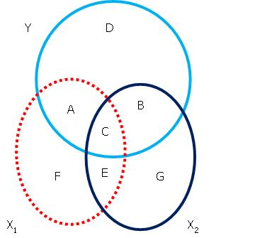
Semi-Partial Correlation (or Part Correlation)
Consider a regression model between a response variable Y and two independent variables X₁ and X₂.
The semi-partial (or part correlation) between a response variable Y and independent variable X₁ measures the relationship between Y and X₁ when the influence of X₂ is removed from only X₁ but not from Y.
It is equivalent to removing portions C and E from X₁ in the Venn diagram shown in Figure
Semi-partial correlation between Y and X₁, when influence of X2 is removed from X1 is given by

Slide 20
Semi-partial (part) correlation plays an important role in regression model building.
The increase in R-square (coefficient of determination), when a new variable is added into the model, is given by the square of the semi-partial correlation.

Slide 21
Example
The cumulative television rating points (CTRP) of a television program, money spent on promotion (denoted as P), and the advertisement revenue (in Indian rupees denoted as R) generated over one-month period for 38 different television programs is provided in Table 10.1. Develop a multiple regression model to understand the relationship between the advertisement revenue (R) generated as response variable and promotions (P) and CTRP as

Slide 22
Serial | CTRP | P | R | Serial | CTRP | P | R
1 | 133 | 111600 | 1197576 | 20 | 156 | 104400 | 1326360
2 | 111 | 104400 | 1053648 | 21 | 119 | 136800 | 1162596
3 | 129 | 97200 | 1124172 | 22 | 125 | 115200 | 1195116
4 | 117 | 79200 | 987144 | 23 | 130 | 115200 | 1134768
5 | 130 | 126000 | 1283616 | 24 | 123 | 151200 | 1269024
6 | 154 | 108000 | 1295100 | 25 | 128 | 97200 | 1118688
7 | 149 | 147600 | 1407444 | 26 | 97 | 122400 | 904776
8 | 90 | 104400 | 922416 | 27 | 124 | 208800 | 1357644
9 | 118 | 169200 | 1272012 | 28 | 138 | 93600 | 1027308
10 | 131 | 75600 | 1064856 | 29 | 137 | 115200 | 1181976
11 | 141 | 133200 | 1269960 | 30 | 129 | 118800 | 1221636
12 | 119 | 133200 | 1064760 | 31 | 97 | 129600 | 1060452
13 | 115 | 176400 | 1207488 | 32 | 133 | 100800 | 1229028
14 | 102 | 180000 | 1186284 | 33 | 145 | 147600 | 1406196
15 | 129 | 133200 | 1231464 | 34 | 149 | 126000 | 1293936
16 | 144 | 147600 | 1296708 | 35 | 122 | 108000 | 1056384
17 | 153 | 122400 | 1320648 | 36 | 120 | 194400 | 1415316
18 | 96 | 158400 | 1102704 | 37 | 128 | 176400 | 1338060
19 | 104 | 165600 | 1184316 | 38 | 117 | 172800 | 1457400

Slide 23
The MLR model is given by
The regression coefficients can be estimated using OLS estimation. The SPSS output for the above regression model is provided in tables
Model Summary
Model | R | R-Square | Adjusted R-Square | Std. Error of the Estimate
1 | 0.912ª | 0.832 | 0.822 | 57548.382

Slide 24
Coefficients
Model |  | Unstandardized Coefficients |  | Standardized Coefficients | t | Sig.
 |  | B | Std. Error | Beta
1 | Constant | 41008.840 | 90958.920 |  | 0.451 | 0.655
 | CTRP | 5931.850 | 576.622 | 0.732 | 10.287 | 0.000
 | P | 3.136 | 0.303 | 0.736 | 10.344 | 0.000
The regression model after estimation of the parameters is given by
For every one unit increase in CTRP, the revenue increases by 5931.850 when the variable promotion is kept constant, and for one unit increase in promotion the revenue increases by 3.136 when CTRP is kept constant. Note that television-rating point is likely to change when the amount spent on promotion is changed.

Slide 25
Standardized Regression Co-efficient
A regression model can be built on standardized dependent variable and standardized independent variables, the resulting regression coefficients are then known as standardized regression coefficients.
The standardized regression coefficient can also be calculated using the following formula:
Where is the standard deviation of the explanatory variable Xi and SY is the standard deviation of the response variable Y.

Slide 26
Regression Models with Qualitative Variables
In MLR, many predictor variables are likely to be qualitative or categorical variables. Since the scale is not a ratio or interval for categorical variables, we cannot include them directly in the model, since its inclusion directly will result in model misspecification. We have to pre-process the categorical variables using dummy variables for building a regression model.

Slide 27
Example
The data in Table provides salary and educational qualifications of 30 randomly chosen people in Bangalore. Build a regression model to establish the relationship between salary earned and their educational qualifications.
S. No. | Education | Salary | S. No. | Education | Salary | S. No. | Education | Salary
1 | 1 | 9800 | 11 | 2 | 17200 | 21 | 3 | 21000
2 | 1 | 10200 | 12 | 2 | 17600 | 22 | 3 | 19400
3 | 1 | 14200 | 13 | 2 | 17650 | 23 | 3 | 18800
4 | 1 | 21000 | 14 | 2 | 19600 | 24 | 3 | 21000
5 | 1 | 16500 | 15 | 2 | 16700 | 25 | 4 | 6500
6 | 1 | 19210 | 16 | 2 | 16700 | 26 | 4 | 7200
7 | 1 | 9700 | 17 | 2 | 17500 | 27 | 4 | 7700
8 | 1 | 11000 | 18 | 2 | 15000 | 28 | 4 | 5600
9 | 1 | 7800 | 19 | 3 | 18500 | 29 | 4 | 8000
10 | 1 | 8800 | 20 | 3 | 19700 | 30 | 4 | 9300

Slide 28
Solution
Note that, if we build a model Y = β ₀ + β₁ × Education, it will be incorrect. We have to use 3 dummy variables since there are 4 categories for educational qualification. Data in Table 10.12 has to be pre-processed using 3 dummy variables (HS, UG and PG) as shown in Table.
Pre-processed data (sample)
Observation | Education | Pre-processed data |  |  | Salary
 |  | High School (HS) | Under-Graduate (UG) | Post-Graduate (PG)
1 | 1 | 1 | 0 | 0 | 9800
11 | 2 | 0 | 1 | 0 | 17200
19 | 3 | 0 | 0 | 1 | 18500
27 | 4 | 0 | 0 | 0 | 7700

Slide 29
The corresponding regression model is as follows:
Y = β₀ + β₁ × HS + β₂ × UG + β₃ × PG
where HS, UG, and PG are the dummy variables corresponding to the categories high school, under-graduate, and post-graduate, respectively.
The fourth category (none) for which we did not create an explicit dummy variable is called the base category. In Eq, when HS = UG = PG = 0, the value of Y is β₀, which corresponds to the education category, “none”.
The SPSS output for the regression model in Eq. using the data in above Table is shown in Table in next slide.

Slide 30
Table 10.14 Coefficients
Model |  | Unstandardized Coefficients |  | Standardized Coefficients | t-value | p-value
 |  | B | Std. Error | Beta
1 | (Constant) | 7383.333 | 1184.793 |  | 6.232 | 0.000
 | High-School (HS) | 5437.667 | 1498.658 | 0.505 | 3.628 | 0.001
 | Under-Graduate (UG) | 9860.417 | 1567.334 | 0.858 | 6.291 | 0.000
 | Post-Graduate (PG) | 12350.000 | 1675.550 | 0.972 | 7.371 | 0.000
The corresponding regression equation is given by
Y = 7383.33 + 5437.667 × HS + 9860.417 × UG + 12350.00 × PG
Note that in Table 10.4, all the dummy variables are statistically significant α = 0.01, since p-values are less than 0.01.

Slide 31
Interpretation of Regression Coefficients of Categorical Variables
In regression model with categorical variables, the regression coefficient corresponding to a specific category represents the change in the value of Y from the base category value (β₀).

Slide 32
Interaction Variables in Regression Models
Interaction variables are basically inclusion of variables in the regression model that are a product of two independent variables (such as X₁ X₂).
Usually the interaction variables are between a continuous and a categorical variable.
The inclusion of interaction variables enables the data scientists to check the existence of conditional relationship between the dependent variable and two independent variables.

Slide 33
Example
The data in below table provides salary, gender, and work experience (WE) of 30 workers in a firm. In Table gender = 1 denotes female and 0 denotes male and WE is the work experience in number of years. Build a regression model by including an interaction variable between gender and work experience. Discuss the insights based on the regression output.
S. No. | Gender | WE | Salary | S. No. | Gender | WE | Salary
1 | 1 | 2 | 6800 | 16 | 0 | 2 | 22100
2 | 1 | 3 | 8700 | 17 | 0 | 1 | 20200
3 | 1 | 1 | 9700 | 18 | 0 | 1 | 17700
4 | 1 | 3 | 9500 | 19 | 0 | 6 | 34700
5 | 1 | 4 | 10100 | 20 | 0 | 7 | 38600
6 | 1 | 6 | 9800 | 21 | 0 | 7 | 39900
7 | 0 | 2 | 14500 | 22 | 0 | 7 | 38300
8 | 0 | 3 | 19100 | 23 | 0 | 3 | 26900
9 | 0 | 4 | 18600 | 24 | 0 | 4 | 31800
10 | 0 | 2 | 14200 | 25 | 1 | 5 | 8000
11 | 0 | 4 | 28000 | 26 | 1 | 5 | 8700
12 | 0 | 3 | 25700 | 27 | 1 | 3 | 6200
13 | 0 | 1 | 20350 | 28 | 1 | 3 | 4100
14 | 0 | 4 | 30400 | 29 | 1 | 2 | 5000
15 | 0 | 1 | 19400 | 30 | 1 | 1 | 4800

Slide 34
Solution
Let the regression model be:
Y = β₀ + β₁ × Gender + β₂ × WE + β₃ × Gender × WE
The SPSS output for the regression model including interaction variable is given in Table
Model |  | Unstandardized Coefficients |  | Standardized Coefficients | T | Sig.
 |  | B | Std. Error | Beta
1 | (Constant) | 13443.895 | 1539.893 |  | 8.730 | 0.000
 | Gender | −7757.751 | 2717.884 | −0.348 | −2.854 | 0.008
 | WE | 3523.547 | 383.643 | 0.603 | 9.184 | 0.000
 | Gender*WE | −2913.908 | 744.214 | −0.487 | −3.915 | 0.001

Slide 35
The regression equation is given by
Y = 13442.895 – 7757.75 Gender + 3523.547 WE – 2913.908 Gender × WE
Equation can be written as
For Female (Gender = 1)
Y = 13442.895 – 7757.75 + (3523.547 – 2913.908) WE
For Male (Gender = 1)
Y = 13442.895 + 3523.547 WE
That is, the change in salary for female when WE increases by one year is 609.639 and for male is 3523.547. That is the salary for male workers is increasing at a higher rate compared female workers. Interaction variables are an important class of derived variables in regression model building.

Slide 36
Validation of Multiple Regression Model
The following measures and tests are carried out to validate a multiple linear regression model:
Coefficient of multiple determination (R-Square) and Adjusted R-Square, which can be used to judge the overall fitness of the model.
t-test to check the existence of statistically significant relationship between the response variable and individual explanatory variable at a given significance level (α) or at (1 − α)100% confidence level.

Slide 37
F-test to check the statistical significance of the overall model at a given significance level (α) or at (1 − α)100% confidence level.
Conduct a residual analysis to check whether the normality, homoscedasticity assumptions have been satisfied. Also, check for any pattern in the residual plots to check for correct model specification.
Check for presence of multi-collinearity (strong correlation between independent variables) that can destabilize the regression model.
Check for auto-correlation in case of time-series data.

Slide 38
Co-efficient of Multiple Determination (R-Square) and Adjusted R-Square
As in the case of simple linear regression, R-square measures the proportion of variation in the dependent variable explained by the model. The co-efficient of multiple determination (R-Square or R²) is given by

Slide 39
SSE is the sum of squares of errors and SST is the sum of squares of total deviation. In case of MLR, SSE will decrease as the number of explanatory variables increases, and SST remains constant.
To counter this, R2 value is adjusted by normalizing both SSE and SST with the corresponding degrees of freedom. The adjusted R-square is given by

Slide 40
R-square | Adjusted R-square
Measures the proportion of the variance in Y that is explained by the X variables | Adjusted R-square improves only when the new explanatory variables genuinely improve the model. Penalizes the addition of new X variables.
Non-decreasing function of the number of X variables in the linear regression model. Increases when more number of explanatory variables are added to the model, irrespective of their relevance in the model. | Prevents overfitting of model. The value of adjusted R-square may increase, decrease or remain the same as more variables are added in the model.
Takes values between 0 and 1 | Adjusted R-square may take negative values.
 | Adjusted R-square value is less than R-square value.

Slide 41
Statistical Significance of Individual Variables in MLR – t-test
Checking the statistical significance of individual variables is achieved through t-test. Note that the estimate of regression coefficient is given by Eq:
This means the estimated value of regression coefficient is a linear function of the response variable. Since we assume that the residuals follow normal distribution, Y follows a normal distribution and the estimate of regression coefficient also follows a normal distribution. Since the standard deviation of the regression coefficient is estimated from the sample, we use a t-test.

Slide 42
The null and alternative hypotheses in the case of individual independent variable and the dependent variable Y is given, respectively, by
H₀: There is no relationship between independent variable X_{i} and dependent variable Y
H_{A}: There is a relationship between independent variable X_{i} and dependent variable Y
Alternatively,
H₀: β_{i} = 0
H_{A}: β_{i} ≠ 0
The corresponding test statistic is given by

Slide 43
Validation of Overall Regression Model – F-test
Analysis of Variance (ANOVA) is used to validate the overall regression model. If there are k independent variables in the model, then the null and the alternative hypotheses are, respectively, given by
H₀: ₁ = ₂ = ₃ = … = _{k} = 0
H₁: Not all s are zero.
F-statistic is given by:
F = MSR/MSE=(SSR/k)/(SSE/(n-k-1))

Slide 44
Validation of Portions of a MLR Model – Partial F-test
The objective of the partial F-test is to check where the additional variables (X_{r+1}, X_{r+2}, …, X_{k}) in the full model are statistically significant.
The corresponding partial F-test has the following null and alternative hypotheses:
H₀: β_{r+1} = β_{r+2} = … = β_{k} = 0
H₁: Not all β_{r+1}, β_{r+2}, …, β_{k} are zero
The partial F-test statistic is given by

Slide 45
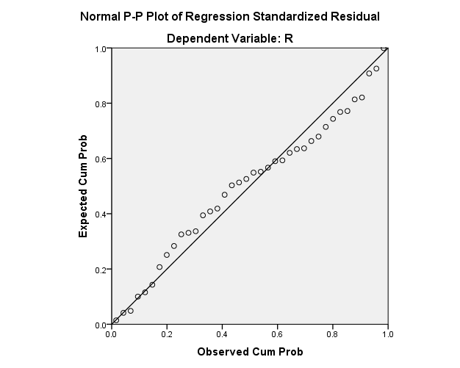
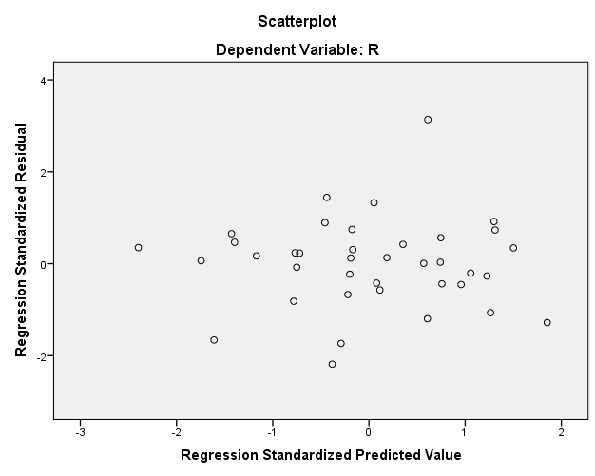
Residual Analysis in Multiple Linear Regression
Residual analysis is important for checking assumptions about normal distribution of residuals, homoscedasticity, and the functional form of a regression model.

Slide 46
Multi-Collinearity and Variance Inflation Factor
Multi-collinearity can have the following impact on the model:
The standard error of estimate of a regression coefficient may be inflated, and may result in retaining of null hypothesis in t-test, resulting in rejection of a statistically significant explanatory variable.
The t-statistic value is
If is inflated, then the t-value will be underestimated resulting in high p-value that may result in failing to reject the null hypothesis.
Thus, it is possible that a statistically significant explanatory variable may be labelled as statistically insignificant due to the presence of multi-collinearity.

Slide 47
Impact of Multicollinearity
The sign of the regression coefficient may be different, that is, instead of negative value for regression coefficient, we may have a positive regression coefficient and vice versa.
Adding/removing a variable or even an observation may result in large variation in regression coefficient estimates.

Slide 48
Variance Inflation Factor (VIF)
Variance inflation factor (VIF) measures the magnitude of multi-collinearity. Let us consider a regression model with two explanatory variables defined as follows:
To find whether there is multi-collinearity, we develop a regression model between the two explanatory variables as follows:

Slide 49
Variance inflation factor (VIF) is then given by:
The value is called the tolerance
is the value by which the t-statistic is deflated. So, the actual t-value is given by

Slide 50
Remedies for Handling Multi-Collinearity
When there are many variables in the data, the data scientists can use Principle Component Analysis (PCA) to avoid multi-collinearity.
PCA will create orthogonal components and thus remove potential multi-collinearity. In the recent years, authors use advanced regression models such as Ridge regression and LASSO regression to handle multi-collinearity.

Slide 51
Auto-Correlation
Auto-correlation is the correlation between successive error terms in a time-series data. Consider a time-series model as defined below:

Slide 52
Durbin−Watson Test for Auto-Correlation
Durbin−Watson is a hypothesis test to check the existence of auto-correlation (Durbin and Watson, 1950, . Let ρ be the correlation between error terms (ε_{t}, ε_{t−1}). The null and alternative hypotheses are stated below:
H0: ρ = 0
H1: ρ ≠ 0
The Durbin−Watson statistic, D, for correlation between errors of one lag is given by

Slide 53
The Durbin−Watson test has two critical values, D_{L} and D_{U}. The inference of the test can be made based on the following conditions:
If D < D_{L}, then the errors are positively correlated.
If D > D_{L}, then there is no evidence for positive auto-correlation.
If D_{L} < D < D_{U}, the Durbin−Watson test is inconclusive.
If (4 − D) < D_{L}, then errors are negatively correlated.
If (4 − D) > D_{U}, there is no evidence for negative auto-correlation.
If D_{L} < (4 − D) < D_{U}, the test is inconclusive.

Slide 54
Distance Measures and Outliers Diagnostics
The following distance measures are used for diagnosing the outliers and influential observations in MLR model.
Mahalanobis Distance
Cook’s Distance
Leverage Values
DFFIT and DFBETA Values

Slide 55
Mahalanobis Distance
Mahalanobis distance (1936) is a distance between a specific observation and the centroid of all observations of the predictor variables.
Mahalanobis distance overcomes the drawbacks of Euclidian distance while measuring distances between multivariate data.
Mathematically, Mahalanobis distance, DM, is given by (Warrant et al. 2011)

Slide 56
Cook’s Distance
Cook’s distance (Cook, 1977) measures the change in the regression parameters and thus how much the predicted value of the dependent variable changes for all the observations in the sample when a particular observation is excluded from sample for the estimation of regression parameters.
Cook’s distance for multiple linear regression is given by (Bingham 1977, Chatterjee and Hadi 1986)

Slide 57
Leverage Value (or Hat Value)
Leverage value of an observation measures the influence of that observation on the overall fit of the regression function and is related to the Mahalanobis distance
Leverage point hi is nothing but the i^{th} diagonal element of the hat matrix,
Leverage value for an observation in MLR is given by

Slide 58
DFFIT and SDFFIT
DFFIT measures the difference in the fitted value of an observation when that particular observation is removed from the model building. DFFIT is given by
where, is the predicted value of i^{th} observation including i^{th} observation, is the predicted value of i^{th} observation after excluding i^{th} observation from the sample.

Slide 59
The standardized DFFIT (SDFFIT) is given by (Belsley et al. 1980, Ryan 1990)
S_{e}(i) is the standard error of estimate of the model after removing i^{th} observation and h_{i} is the i^{th} diagonal element in the hat matrix. The threshold for DFFIT is defined using Standardized DFFIT (SDFFIT). The value of SDFFIT should be less than

Slide 60
DFBETA and SDFBETA
DFBETA measures the change in the regression coefficient when an observation “i” is excluded from the model building. DFBETA is given by
where DFBETA_{i}(j)is the change in the regression coefficient for independent variable j when observation i is excluded.

Slide 61
The standardized DFBETA value (SDFBETA) for observation i is given by (Belsley et al 1980, Ryan 1990)
SDFBETAi(j) is the standardized DFBETA value for variable j after removing observation i and is the standard error of after removing observation i.

Slide 62
Variable Selection in Regression Model Building (Forward, Backward, and Stepwise Regression)

Slide 63
Forward Selection
The following steps are used in building regression model using forward selection method.
Step 1: Start with no variables in the model. Calculate the correlation between dependent and all independent variables.
Step 2: Develop simple linear regression model by adding the variable for which the correlation coefficient is highest with the dependent variable (say variable X_{i}). Note that a variable can be added only when the corresponding p-value is less than the value α. Let the model be Y = β₀ + β₁X_{i}. Create a new model Y = α₀ + α₁ X_{i} + α₂ X_{j} (j ≠i), there will be (k-1) such models. Conduct a partial-F test to check whether the variable X_{j} is statistically significant at α.

Slide 64
Step 3: Add the variable X_{j} from step 2 with smallest p-value based on partial F-test if the p-value is less than the significance α.
Step 4: Repeat step 3 till the smallest p-value based on partial F-test is greater than α or all variables are exhausted.

Slide 65
Backward Elimination Procedure
Step 1: Assume that the data has “n” explanatory variables. We start with a multiple regression model with all n variables. That is Y = β₀ + β₁ X₁ + β₂ X₂ + … + β_{n}X_{n}. We call this full model.
Step 2: Remove one variable at a time repeatedly from the model in step 1 and create a reduced model (say model 2), there will be k such models. Perform a partial F-test between the models in step 1 and step 2.
Step 3: Remove the variable with largest p-value (based on partial F-test) if the p-value is greater than the significance α (or the F-value is less than the critical F-value).
Step 4 : Repeat the procedure till the p-value becomes less than α or there are no variables in the model for which the p-value is greater than α based on partial F-test.

Slide 66
Stepwise Regression
Stepwise regression is a combination of forward selection and backward elimination procedure
In this case, we set the entering criteria (α) for a new variable to enter the model based on the smallest p-value of the partial F-test and removal criteria (β) for a variable to be removed from the model if the p-value exceeds a pre-defined value based on the partial F-test (α < β).

Slide 67
Transformations
Transformation is a process of deriving new dependent and/or independent variables to identify the correct functional form of the regression model
Transformation in MLR is used to address the following issues:
Poor fit (low R² value).
Patten in residual analysis indicating potential non-linear relationship between the dependent and independent variable. For example, Y = β₀ + β₁X₁ + β₂ X₂ is used for developing the model instead or ln(Y) = β₀ + β₁ X₁ + β₂ X₂, resulting in clear pattern in residual plot.
Residuals do not follow a normal distribution.
Residuals are not homoscedastic.

Slide 68
Example
Table shows the data on revenue generated (in million of rupees) from a product and the promotion expenses (in million of rupees). Develop an appropriate regression model
S. No. | Revenue in Millions | Promotion Expenses | S. No. | Revenue in Millions | Promotion Expenses
1 | 5 | 1 | 13 | 16 | 7
2 | 6 | 1.8 | 14 | 17 | 8.1
3 | 6.5 | 1.6 | 15 | 18 | 8
4 | 7 | 1.7 | 16 | 18 | 10
5 | 7.5 | 2 | 17 | 18.5 | 8
6 | 8 | 2 | 18 | 21 | 12.7
7 | 10 | 2.3 | 19 | 20 | 12
8 | 10.8 | 2.8 | 20 | 22 | 15
9 | 12 | 3.5 | 21 | 23 | 14.4
10 | 13 | 3.3 | 22 | 7.1 | 1
11 | 15.5 | 4.8 | 23 | 10.5 | 2.1
12 | 15 | 5 | 24 | 15.8 | 4.75

Slide 69
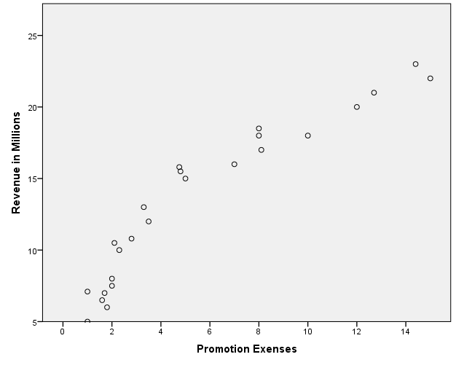
Let Y = Revenue Generated and X = Promotion Expenses
The scatter plot between Y and X for the data in Table is shown in Figure .
It is clear from the scatter plot that the relationship between X and Y is not linear; it looks more like a logarithmic function.

Slide 70
Consider the function Y = β₀ + β₁X. The output for this regression is shown in below tables and in Figure . There is a clear increasing and decreasing pattern in Figure indicating non-linear relationship between X and Y.
Model Summary
Model | R | R-Square | Adjusted R-Square | Std. Error of the Estimate
1 | 0.940 | 0.883 | 0.878 | 1.946
Coefficients
Model |  | Unstandardized Coefficients |  | Standardized Coefficients | T | Sig.
 |  | B | Std. Error | Beta
1 | (Constant) | 6.831 | 0.650 |  | 10.516 | 0.000
 | Promotion Expenses | 1.181 | 0.091 | 0.940 | 12.911 | 0.000

Slide 71
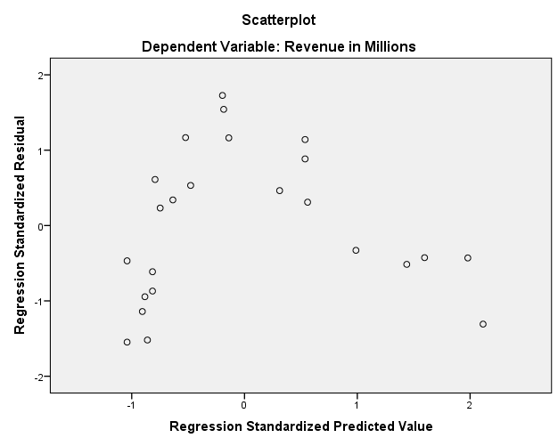

Slide 72
Since there is a pattern in the residual plot, we cannot accept the linear model (Y = β₀ + β₁X).
Next we try the model Y = β₀ + β₁ ln(X). The SPSS output for Y = β₀ + β₁ln(X) is shown in Tables 10.31 and 10.32 and the residual plot is shown in Figure 10.11.
Note that for the model Y = β₀ + β₁ln(X), the R²-value is 0.96 whereas the R²-value for the model Y = β₀ + β₁X is 0.883. Most important, there is no obvious pattern in the residual plot of the model Y = β₀ + β₁ln(X). The model Y = β₀ + β₁ln(X) is preferred over the model Y = β₀ + β₁X.

Slide 73
Model Summary
Model | R | R-Square | Adjusted R-Square | Std. Error of the Estimate
1 | 0.980 | 0.960 | 0.959 | 1.134
Coefficients
Model |  | Unstandardized Coefficients |  | Standardized Coefficients | t | Sig.
 |  | B | Std. Error | Beta
1 | (Constant) | 4.439 | 0.454 |  | 9.771 | 0.000
 | ln (X) | 6.436 | 0.279 | 0.980 | 23.095 | 0.000

Slide 74
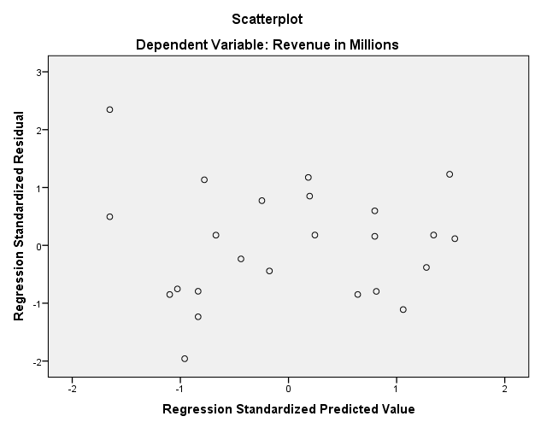
Residual plot for the model Y = β₀ + β₁ln(X).

Slide 75
Summary
Multiple linear regression model is used to find existence of association relationship between a dependent variable and more than one independent variables.
In MLR, the regression coefficients are called partial regression coefficients, since it measures the change in the value of dependent variable for every one unit change in the value of independent variable, when all other independent variables in the model are kept constant.
When a new variable is added to a MLR model, the increase in R² is given by the square of the part-correlation (semi-partial correlation) between the dependent variable and the newly added variable.

Slide 76
While building MLR model, the categorical variables with n categories should be replaced with (n-1) dummy (binary) variables to avoid model mis-specification.
Apart from checking for normality, heteroscedasticity, every MLR model should be checked for presence of multi-collinearity, since multi-collinearity can destabilize the MLR model.
If the data is time-series, then there could be auto-correlation which can result in adding a variable which is statistically not significance. The presence of auto-correlation can result in inflating the t-statistic value.
Variable selection is an important step in MLR model building. Several strategies such as forward, backward and stepwise variable selection are used in building the model. Partial F-test is one of the frequently used approached for variable selection.

